Slide 1
Mobile 3D Graphics
March 22 2007

Slide 2
Brief History
Mobile 3D graphics revolution started small.
First phone with embedded a Mascot Capsule 3D engine was from J-Phone in 2001.
Mascot Capsule works on resource-constrained environments and runs on engines capable of 32-bit integer operations (floating-point operations and divisions are not required) with 10 MHz or higher clock speed.
First 3D graphics phone outside Japan was the Nokia 3410 GSM phone, shipped in 2002.

Slide 3
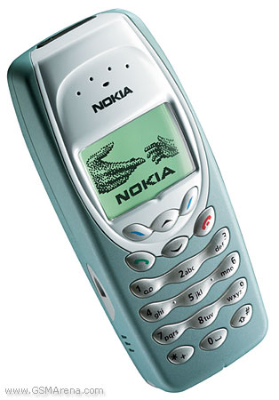
Monochrome graphics
96 x 65 pixels, dynamic font size
3D screensavers
Built-in 3D Java game.
The ability to input a text string and select pre-canned 3D animations was more popular than downloading 3D screensavers.
Nokia 3410

Slide 4
Khronos Group
A member-funded industry consortium focused on the creation of open standard, royalty-free APIs.
APIs enable the authoring and accelerated playback of dynamic media on a wide variety of platforms and devices.
Members contribute to the development of Khronos API specifications and are able to accelerate the delivery of their cutting-edge 3D platforms and applications through early access to specification drafts and conformance tests.

Slide 5
Khronos and 3D Graphics
In 2002, decided to form a steering committee to define a subset of OpenGL suitable for embedded devices.
Concurrently, JSR 184 led by Nokia was started to standardize 3D graphics API for Java ME.
Finally, in 2003, OpenGL ES 1.0 and M3G 1.0 were born.

Slide 6
Mobile 3D Standards
Two widely adopted standards:
  OpenGL ES for native 3D rendering.
  M3G for Java based 3D rendering.
Standard APIs are beneficial w.r.t portability, documentation, and providing a concrete target for hardware manufacturers.

Slide 7
Design Principles for Standardization
Graphics standards designed based on:
  Capabilities of mobile devices
  Available software platforms.
  Need to create an interesting, unified market for both content developers and hardware vendors.
  Unified solution to cater for both Java and native applications.

Slide 8
Design Principles for Standardization
Performance: Crucial on devices with limited computation.
Low complexity: As a requirement based on stringent Silicon area and ROM footprint budgets of basic mobile phones.
Engines underlying OpenGL ES and M3G were required to be implementable under 50 KB and 150 KB respectively.
Key tricks are removal of redundant and less used features such as feedback and selection modes, indexed color model, display lists.

Slide 9
Design Principles for Standardization
Rich feature set: Not to be compromised when aiming for compact APIs.
Small applications: Applications often delivered over relatively slow over-the-air connections with users paying by the kilobyte and stored in on-device memories.
Hardware-friendly: Provides clear path for hardware evolution. Adopting OpenGL rendering model as the base technology enabled a dedicated hardware for mass markets.

Slide 10
Design Principles for Standardization
Ease of adoption: For wider acceptance among developers and device vendors. Open-standards were good work-arounds for patents.
Productivity: For quicker development times of mobile games. M3G was a good match.
Extensibility: To allow new features to be incorporated.
Minimal fragmentation: Number of optional features were kept small for both OpenGL ES and M3G.

Slide 11
OpenGL ES
Compact version of OpenGL Graphics API.
Low-level rendering API adapted for embedded systems.
OpenGL ES 1.0 fully implementable in < 50KB of code, or hardware accelerated.
OpenGL ES 2.0 supports high-level shading language, replacing traditional fixed-function graphics pipeline with programmable vertex and fragment shaders.
2.x and 1.x series not backwards compatible.

Slide 12
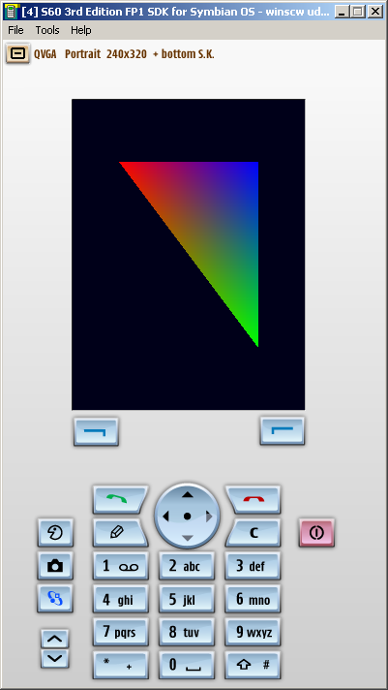
OpenGL ES Example

Slide 13
M3G
Typically software rasterizers written in Java much slower than those in native code.
Decided to come up with a mobile Java API that would shift much of the processing into native code.
Any data needed in native code must be controlled by code than reside in Java heap, i.e. a retained mode design.

Slide 14
M3G
High-level API that borrows from other APIs such as Java 3D.
Consists of nodes encapsulating 3D graphics elements and connected to a scene graph representing the objects and their relationships.
Implemented on top of OpenGL ES engine.
Supports animation.
Standardization effort under JSR 184.

Slide 15
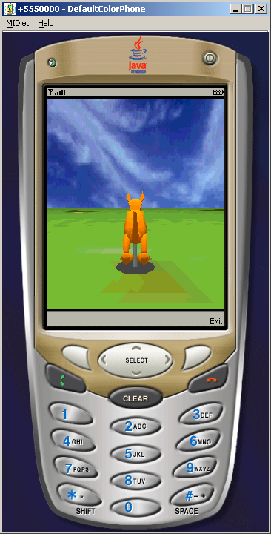
M3G Example

Slide 16
References
OpenGL ES: http://www.khronos.org/opengles/
JSR 184/M3G: http://jcp.org/jsr/detail/184.jsp
We will be discussing the latter after spring break.

Slide 17
Assignment (due April 2, 2007)
Submit a project plan of your class project as a word document. Should contain the following:
  Title of project
  Team members
  Technologies and devices being used
  Weekly project tasks
  Team split (who does what) at least for the first few tasks
Actual projects due on May 10, 2007.
Deliverables include source code, ppt and a poster for the open house.
Start early!

Slide 18
Class Project Discussions

Slide 19
Class Project List
Joel Frank: Image editor
Vaibhav Pandya: ‘Post-its’ Application
Zhi Yao Xie, Khee Wom Wong, Francisco Yip: Online auction application using J2ME

